Slide 1
CVD Training

Slide 2
agenda
Goal: Create a shared understanding of Core Value Drivers (CVDs) by highlighting key topics and resurfacing available resources.
HR CVD Overview
Decoding the CVD Bowler
Annualizing & Forecasting

Slide 3
HR Core Value Drivers (CVDs)
HR Analytics SharePoint | CVD Metrics | CVD Guide & FAQ | CVD Bowlers Template
 | Professional Voluntary Turnover | Internal Fill Rate | Manufacturing Voluntary Turnover
Definition | Turnover rate for professional and above associates that leave the company voluntarily. | Percentage of M1+ level roles that are filled internally | Turnover rate for direct and indirect labor associates that leave the company voluntarily
Population | All career levels, excluding DL/IDL Employees only (no contingent) HR is removed | Supervisor+ (by career level) Employees only (no contingent) HR is removed | DL/IDL Only Employees only (no contingent) HR is removed
Goal | 10% Improvement from 2024 | 50% | Set by business
Audience | L1 (Segment/POR) L2 (Division/BUR) L3 (Plant/SOR) | L1 (Segment/POR) L2 (Division/BUR) L3 (Plant/SOR) | L3 (Plant/SOR)
Primary Metric | Annualized YTD | YTD | Annualized YTD
Forecasting Guidance | Annualized YTD / 12 | YTD | Annualized YTD / 12
Still need help? Start here

Slide 4
Where is the data coming from?
These metrics are based on an Active and Terminated data file from Workday (Talent Hub). That means that the calculations are based on the data that is in Workday today or at the time of termination.
The data is pulled monthly, effective the first of the month.
Each update, the data is re-run for the full year.
This means:
Previous month data can change
Retroactive entries are captured
Data corrections are reflected
 | Workday (Talent Hub) | HR Analytics SharePoint | Future State: Power BI
Purpose | Raw Data Source | Standard Reporting | Insights
Intent | Source of truth | Static metric reporting | Dive deeper into metrics to understand drivers
HR Accountability | Regularly review data for accuracy (e.g., segment assignment) and pull reports for ad-hoc needs | Be prepared to speak to CVD metrics at BURs | Utilize the tool to uncover drivers, hotspots, and trends

Slide 5
Decoding the bowler

Slide 6
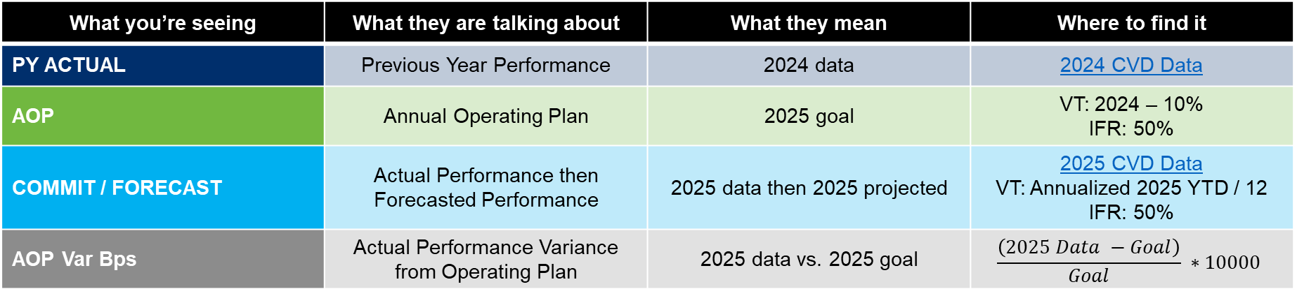
Decoding the cvd bowler
CVD | KPI | YTD | 2025 | Jan | Feb | Mar | Q1 | Apr | … | FY
Professional Turnover | Voluntary Turnover Professional % .0 |  | PY ACTUAL
 |  |  | AOP
 |  |  | COMMIT / FORECAST
 |  |  | AOP Var Bps
What you’re seeing | What they are talking about | What they mean | Where to find it
PY ACTUAL | Previous Year Performance | 2024 data | 2024 CVD Data
AOP | Annual Operating Plan | 2025 goal | VT: 2024 – 10% IFR: 50%
COMMIT / FORECAST | Actual Performance then Forecasted Performance | 2025 data then 2025 projected | 2025 CVD Data VT: Annualized 2025 YTD / 12 IFR: 50%
AOP Var Bps | Actual Performance Variance from Operating Plan | 2025 data vs. 2025 goal | $$\frac{\left(2025 Data −Goal\right)}{Goal} ∗10000$$
VT = Voluntary Turnover
IFR = Internal Fill Rate

Slide 7
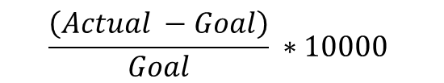
What is a basis point?
Finance often works with tiny numbers where even a one hundredth of a percent can make a big difference.
A basis point (bps) is a unit of measure used in finance to describe the change in a percent.
1 basis point = 0.01% (1 hundredth of a percent)
100 basis points = 1%
Example: If mortgage rates increase from 6.88% to 6.90%, it increased by 2 basis points (or 0.02%).
Note: The bowler uses relative basis points change
$$\frac{\left(Actual −Goal\right)}{Goal} ∗10000$$
Metric | 1% → 2% | 50% → 51%
Absolute change (%) | 1% | 1%
Absolute change (bps) | 100 bps | 100 bps
Relative change (%) | 100% | 2%
Relative change (bps) | 10,000 bps | 200 bps

Slide 8
Annualizing & forecasting

Slide 9

Annualizing and forecasting Voluntary Turnover
YTD Annualized: Projected year-end results based on current year-to-date performance
Monthly Forecast: Prorated projected year-end results
If I read 6 books in the first quarter, and I continue at my current pace, I am projected to read 24 books this year. This means an average of 2 books per month.
YTD: 6 Annualized: 24
Monthly Forecast: 2
Q1 |  |  | Q2 |  |  | Q3 |  |  | Q4
Jan | Feb | Mar | Apr | May | June | July | Aug | Sep | Oct | Nov | Dec
3 | 1 | 2 | 2 | 2 | 2 | 2 | 2 | 2 | 2 | 2 | 2
YTD
* $\left(\frac{12}{Current Month}\right)$ = YTD Annualized
÷ 12 = Monthly Forecast
This is only for voluntary turnover, not internal fill

Slide 10


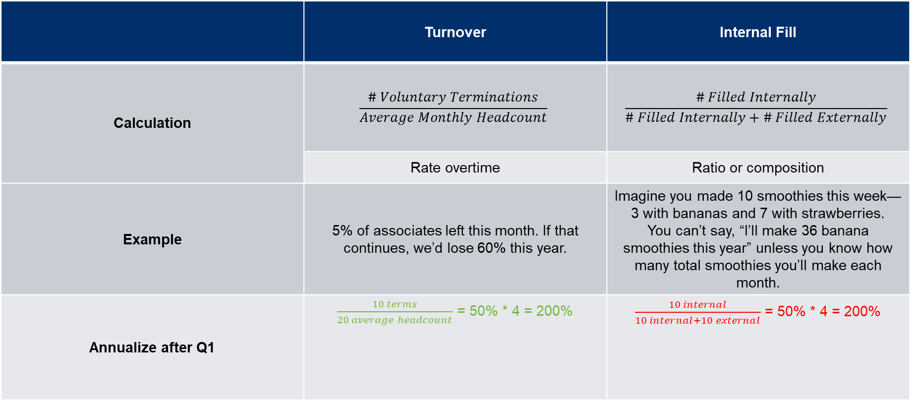
Why annualize turnover and not internal fill?
 | Turnover | Internal Fill
Calculation | $$\frac{\# Voluntary Terminations}{Average Monthly Headcount}$$ | $$\frac{\# Filled Internally}{\# Filled Internally+\# Filled Externally}$$
 | Rate overtime | Ratio or composition
Example | 5% of associates left this month. If that continues, we’d lose 60% this year. | Imagine you made 10 smoothies this week—3 with bananas and 7 with strawberries. You can’t say, “I’ll make 36 banana smoothies this year” unless you know how many total smoothies you’ll make each month.
Annualize after Q1 | $\frac{10 terms}{20 average headcount}$ = 50% * 4 = 200% | $\frac{10 internal}{10 internal+10 external}$ = 50% * 4 = 200%

Slide 11
appendix

Slide 12
Cvd metric populations
Career Level | Career Level Bucket | Internal Fill | Professional Turnover | Manufacturing Turnover
E2 to E5 | VP | X | X
M5 to E1 | Director | X | X
M2 to M4 | Manager | X | X
M1 | Supervisor | X | X
P1 to P6 | Professional |  | X
AT1 to AT4 | Admin/ Technical |  | X
None | DL/IDL |  |  | X

Slide 13

Bowler summary
CVD | KPI | YTD | 2025 | Jan | Feb | Mar | Q1 | Apr | … | FY
Professional Turnover | Voluntary Turnover Professional % .0 |  | PY ACTUAL
 |  |  | AOP
 |  |  | COMMIT / FORECAST
 |  |  | AOP Var %
YTD
* $\left(\frac{12}{Current Month}\right)$
YTD Annualized
÷ 12
Monthly Forecast

Slide 14
Bowler summary
CVD | KPI | YTD | 2025 | Jan
Professional Turnover | Voluntary Turnover Professional % .0 | Annualized YTD | PY ACTUAL | 2024 Actual
 |  |  | AOP | 2024 – 10%
 |  |  | COMMIT / Forecast | 2025 Actual / Annualized YTD / 12
 |  |  | AOP Var Bps | 2025 Actual - AOP
Manufacturing Turnover | DL / IDL Voluntary Turnover % .0 | Annualized YTD | PY ACTUAL | 2024 Actual
 |  |  | AOP | Goal set by business
 |  |  | COMMIT / Forecast | 2025 Actual / Annualized YTD / 12
 |  |  | AOP Var Bps | 2025 Actual - AOP
Leadership Roles Fill Rate | Internal Fill Rate Supervisor+ % .0 | YTD | PY ACTUAL | 2024 Actual
 |  |  | AOP | 50%
 |  |  | COMMIT / Forecast | 2025 Actual / 50%
 |  |  | AOP Var Bps | 2025 Actual - AOP

Slide 15
Bowler guide
 | Levels | YTD | PY Actual | AOP | Commit | Forecast
Professional Voluntary Turnover | L1, L2, L3 | Annualized YTD | 2024 actual | 2024 – 10% | 2025 actual | Annualized YTD / 12
Manufacturing Voluntary Turnover | L3 only | Annualized YTD | 2024 actual | Goal set by business | 2025 actual | Annualized YTD / 12
Internal Fill Rate | L1, L2, L3 | YTD | 2024 actual | 50% | 2025 actual | 50%

